Slide 1
Education 3.0
Continue the Conversation
Rob Kadel, Ph.D.
University of Colorado Denver

Slide 2
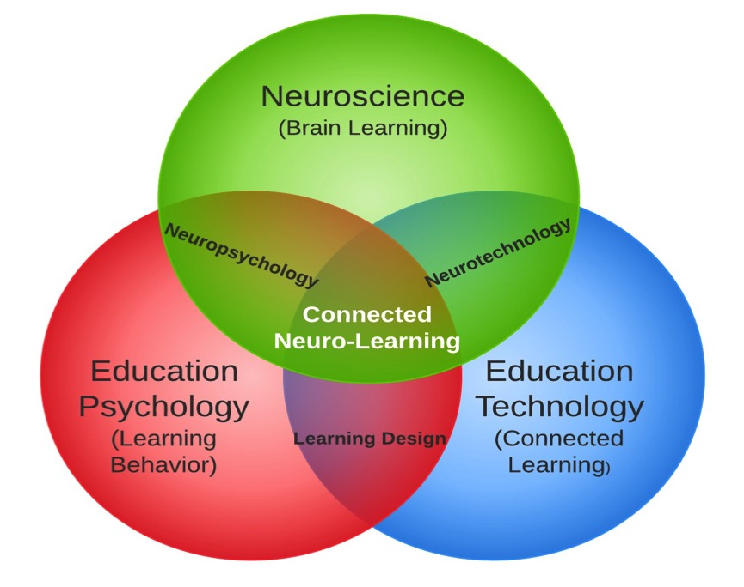

Slide 3
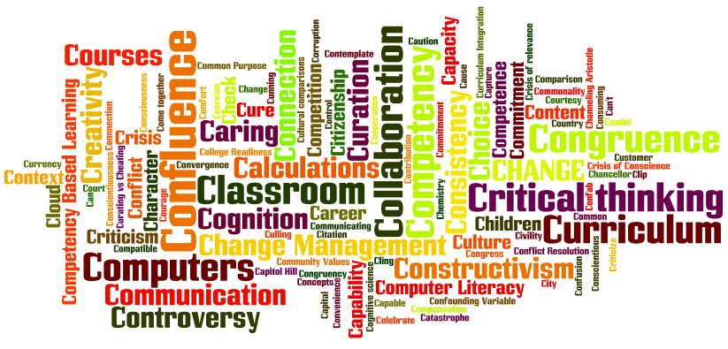
The “C’s” of Education
Notes:
Understanding & identifying how learners incorporate technology into everyday life
Meeting learners in their space
Support for digital learning
Connections & Curation
Communication & Critical Thinking
Effective technology-integrated learning environments

Slide 4
Collaborative Educators

Slide 5
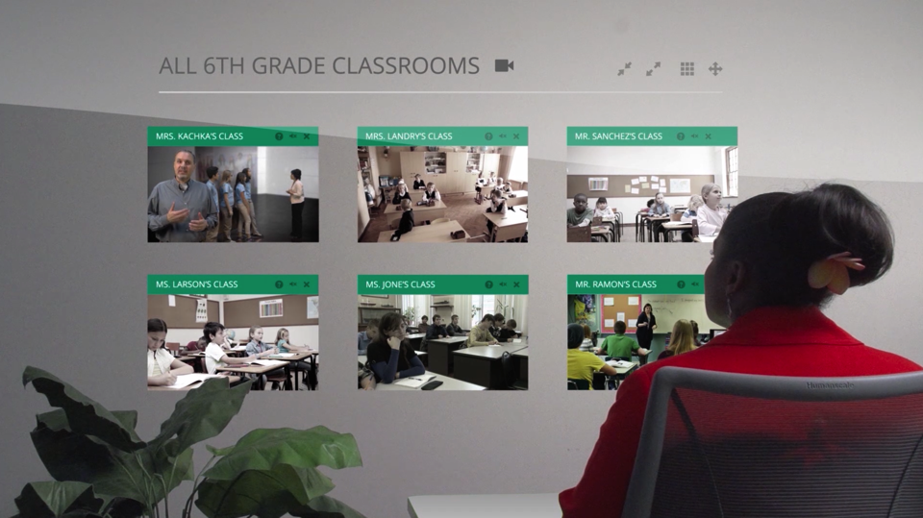
Engaged Administrators

Slide 6
Connected Learners

Slide 7
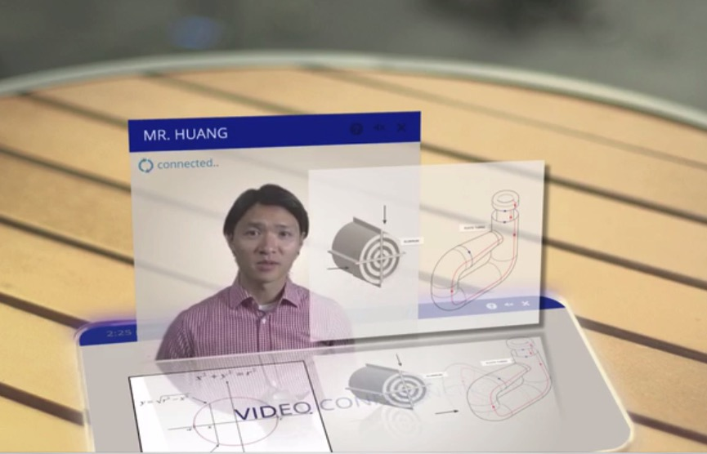
Technology Enabled Education

Slide 8
Do First

Slide 9
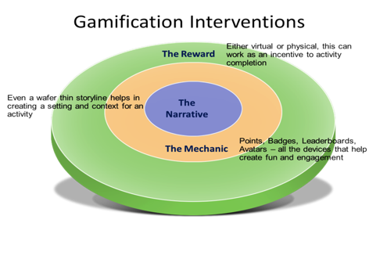
Game Based Learning

Slide 10
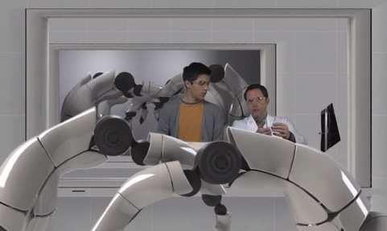
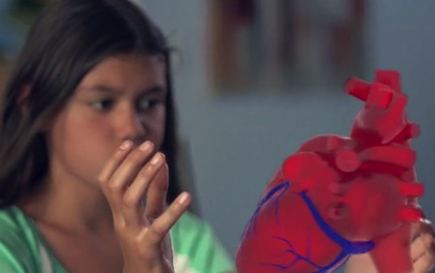
Non-Classroom Work

Slide 11
Doing First
What activities can you think of that would allow your students to “do first”?

Slide 12
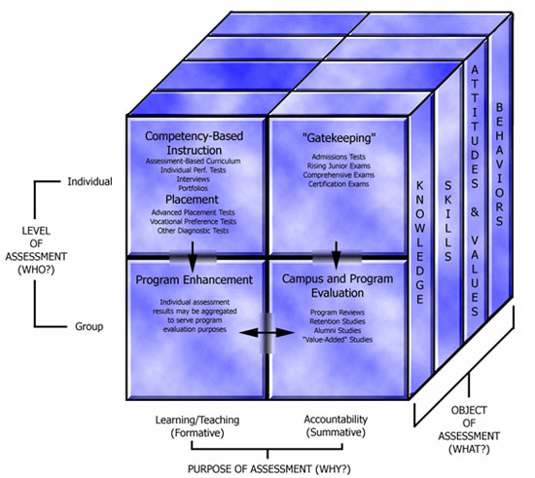
Assessment

Slide 13
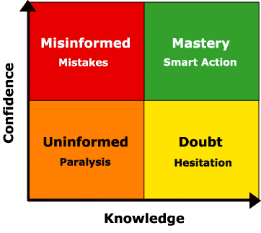
Confidence

Slide 14
Dan Meyer: Compelling Questions

Slide 15
Compelling Questions

Slide 16
Compelling Questions

Slide 17
Compelling Questions
How might you assess your students – in different ways – by asking compelling questions?

Slide 18
Data Dashboards

Slide 19
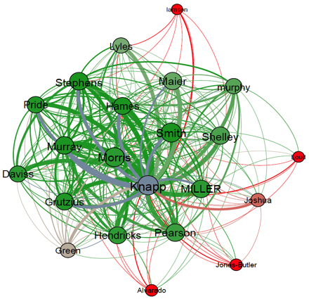
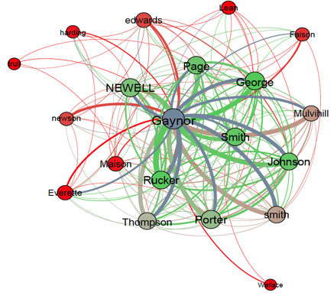
Applying Data to Improve Courses
Notes:
This is the same type graph for the same two courses, but it looks at thread interactions between users in a course.
Here the professor is blue and the colors for the students indicates the final grade in the course with green being higher and red failing or dropping. Again you can see very clearly several things that jump out.
Course 2 is obviously more interactive and the nodes are more tightly clustered.
Several subgroups have sprung up where students are interacting with each other more in course 2 vs just student to professor in course 1.
You can see a few students in each course who reached out through threads many times but didn’t get responses. That seems to trend with poor performance.
Again, these are two sections of the same course with different professors that show clearly different student behavior.
We also see again that these simple visualizations of sample data can show us potential correlations that we want to dig into more. That’s the power of visualization of descriptive analytics.

Slide 20
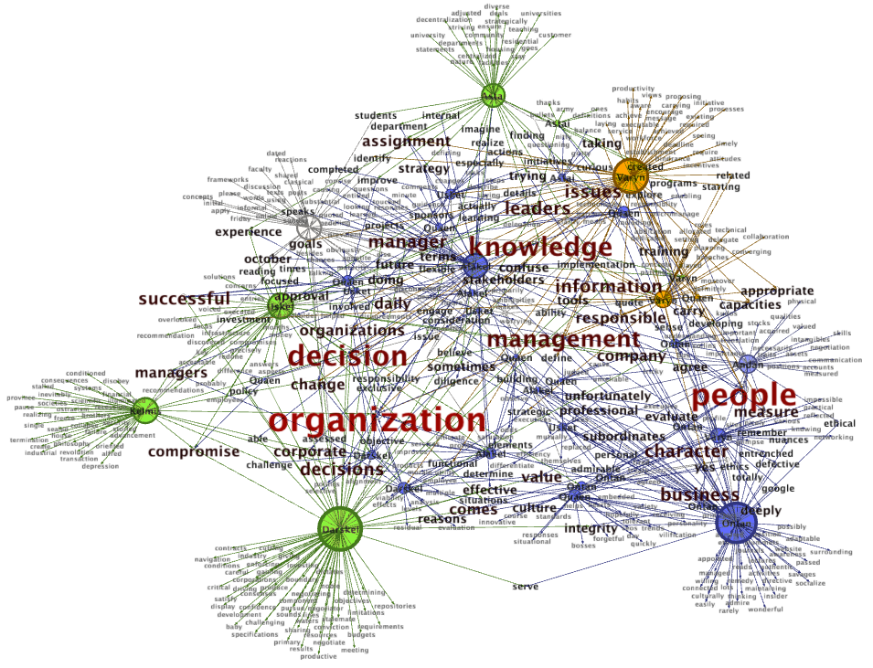

Slide 21
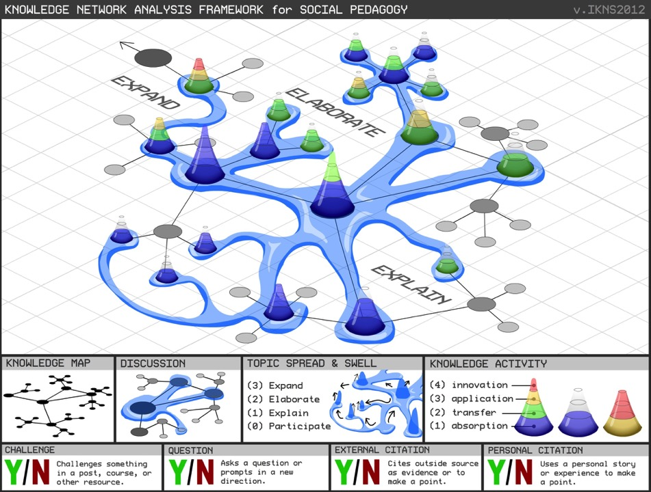

Slide 22
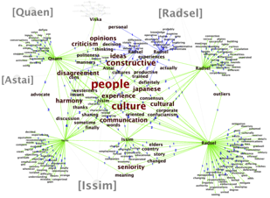
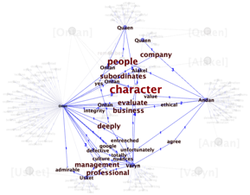
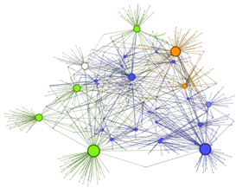
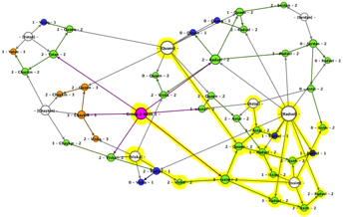
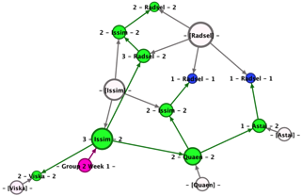

Slide 23
Personalized Learning

Slide 25
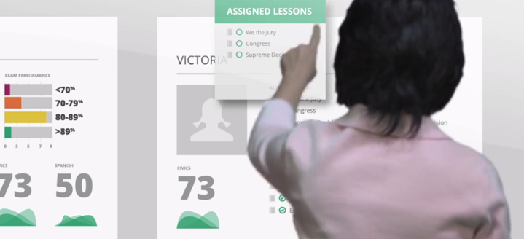
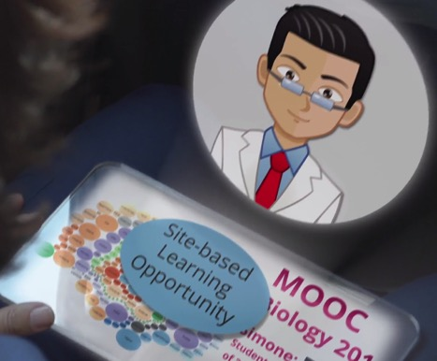
Data → Personalization

Slide 26
Data → Personalization
How might you use data to help personalize instruction for your students?

Slide 27
Putting it into Practice: Creating Outcomes

Slide 28
What Is Measurable?
BROAD
Mission Statement
Institutional Level
Harder To
Measure
Goals
Program Level
Outcomes & Standards
Course Level
Easier To
Measure
Objectives
Instructional Activities
Interaction
Assessment
NARROW
Notes:
Before discussing learning outcome management we need to establish a common understanding of learning outcomes and what is measurable. As the granularity of your learning statements increase, the usefulness of the data you extract from an assessment tracking system will improve. Higher level institutional and program goals are usually not directly measurable meaning you can’t observe that a learning outcome has been achieved. These goals are typically measured with lower level course and task level outcomes and objectives that are measurable. Institutions then prove attainment of higher level (non-measurable) goals by rolling up multiple, measurable lower level outcomes that demonstrate student achievement of mission/goal statements.

Slide 29
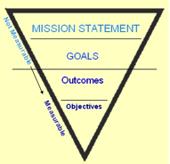
Mission Statement
A mission statement is usually the broadest desired result for a group. Mission statements are NOT measurable.
Example: Completion of a program at our institution will result in a student being a good corporate, public, and private citizen.
Example 2: Our institution promotes honesty and integrity in interactions with others.

Slide 30
(Program) Goals
Sometimes called values, a goal is usually the broader desired result of achieving multiple outcomes. Goals are difficult to measure.
Example: Students should be able to communicate effectively in various contexts and situations.
Example 2: Students should understand how to integrate communication curriculum holistically.

Slide 31
Outcomes
Sometimes called standards, results, or products, an outcome states the results one hopes to attain through intervention activities. Outcomes are measurable and observable.
Example: Students will create a preparation outline for a speech.
Example 2: Students will create a presentation outline for a speech.

Slide 32
Objectives
Sometimes called competencies or skills, a (terminal) objective is a specific, measurable and/or observable element that is typically part of an outcome.
Example: Students will create a complete introduction. (Part of an outline.)

Slide 33
Criteria
Criteria are the elements of a task (test, paper, presentation, portfolio, etc) that the objective or outcome will be observed with or measured by. In other words, what does good performance on the task look like?
Example: An introduction must include at least 4 parts. 1) The attention getter. (required) 2) The greeting. (optional) 3) The goal or Thesis Statement (required) 4a) The statement of goodwill. OR 4b) The statement of credibility. (required) 5. The preview (required)

Slide 34
The Importance of Verbs

Slide 35
Creating Outcomes
What outcomes are important for your students?
How can you make outcomes actionable?

Slide 36
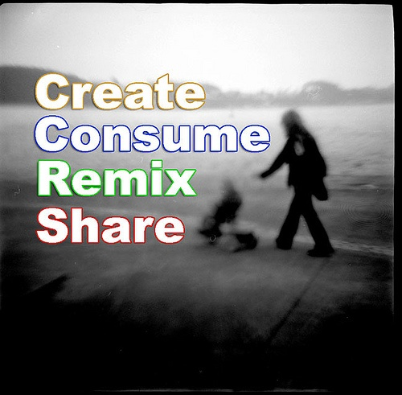
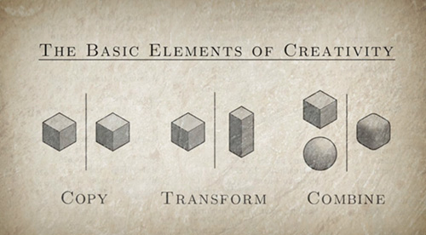
Notes:
But one routine, a really strong closer, that I started using around 2008 is a “bit” that illustrates Create, Consume, Remix, and Share. If you are reading this and have seen me speak in the past 5 years, there is a decent chance you know this routine! It’s based on the notion that there is a HUGE list of songs which share the exact same chord structure. From Stand By Me to We Didn’t Start the Fire to a recent Grammy winning song by Adele, these chords show up over and over again in Western music. And it makes for an outstanding example of the importance of remixing in education. All of life is remixed in some way, shape, or form.
For instance, take the amazing iPhone. Not the iPhone 5, but the original iPhone. Remember all the way back in 2007 when it first appeared? Did Steve Jobs / Apple “invent” the iPhone? Of course they did. But, there is probably a better, more accurate way of saying it. They invented the confluence of technologies assembled in a unique pattern for the first time, but they didn’t “invent” the iPhone. What, you say? What is this nitty picky trickery? Let me explain.
I will never forget the most amazing TED talk I ever watched. It wasn’t Sir Ken Robinson or Dan Pink or Jane McGonigal – all of which are staples for my video consumption today. Nope, it was an awe-inspiring look into the future that captured my imagination. It was Jeff Han’s 2006 showcase of the touch interface. Do you remember it? Likely you don’t. Not because watching pinch and zoom for the first time wasn’t incredible, but mostly because the technology he showed soon became a tv commercial. It soon became the iPhone’s interface and everyone knew the technology.
As you already likely know, Steve Jobs and Apple didn’t invent the touch screen. They just remixed it to serve a purpose until then underutilized.
- See more at: http://researchnetwork.pearson.com/elearning/create-consume-remix-share#sthash.MAp1Zj2l.dpuf

Slide 37
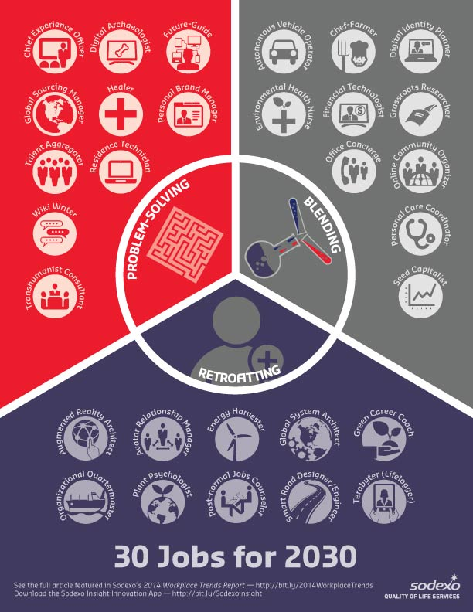

Slide 38
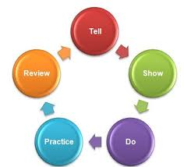
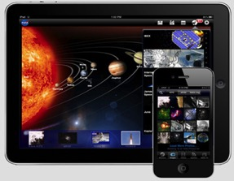
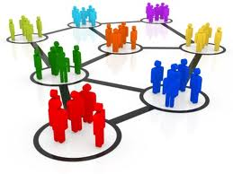
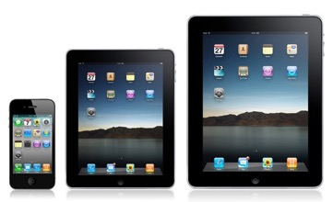
Confluence

Slide 39
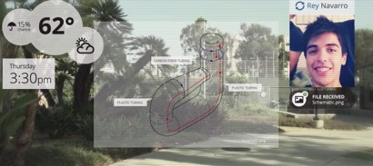
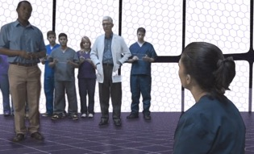
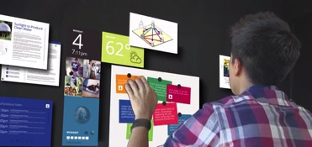
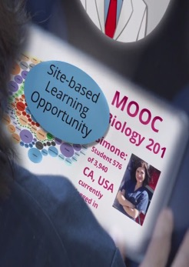
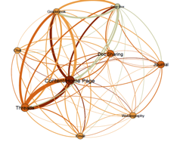
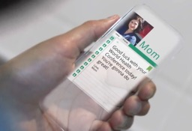
Future Application?

Slide 40
Notes:
The point being that there are lots of answers to the questions you ask. I’m not going to try to lead you down the path to one correct answer today, but rather just get you thinking about alternatives in online and blended courses.

Slide 41
Thank you!
Rob Kadel, Ph.D.
rob.kadel@ucdenver.edu
Twitter: @rkadel42
Web: robkadel.com

